Slide 1
JavaScript JSON

Slide 2
JavaScript JSON
The JavaScript JSON is an acronym of JavaScript Object Notation
It provides a format for storing and transporting data
It is a lightweight human readable collection of data that can be accessed in a logical manner.

Slide 3
Points to remember
It generates and stores the data from user input.
It can transport the data from the server to client, client to server, and server to server
It can also build and verifying the data

Slide 4
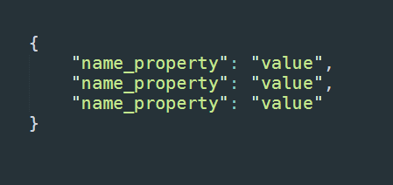
JSON Syntax
While working with .json file, the syntax will be like

Slide 5
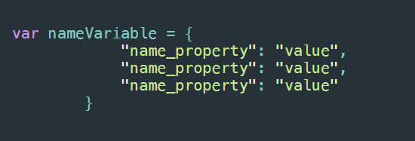
JSON Syntax
While working with JSON object in .js or .html file, the syntax will be like

Slide 6
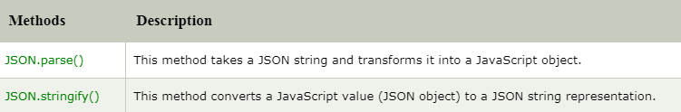
JavaScript JSON Methods

